Slide 1



DEPARTMENT OF CSE
presents
whackiest’25
IDEATHON-2025
Theme : PS1-Endless Trail
Team Name :Team ForgeX
Team Member 1: Yashas N
USN:1MS23AD066
Team Member 2: Naveen G P
USN:1MS23CI073
Team Member 3: Jeeth K
USN:1MS23AD026
Team Member 4: Shrajan Prabhu
USN:1MS23IS116

Slide 2
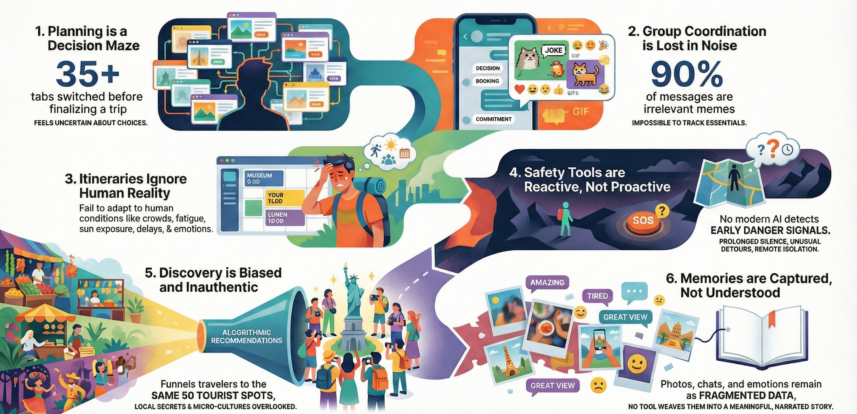
Problem statement
Team ForgeX
THE FUTURE OF TRAVEL NEEDS REINVENTION

Slide 3
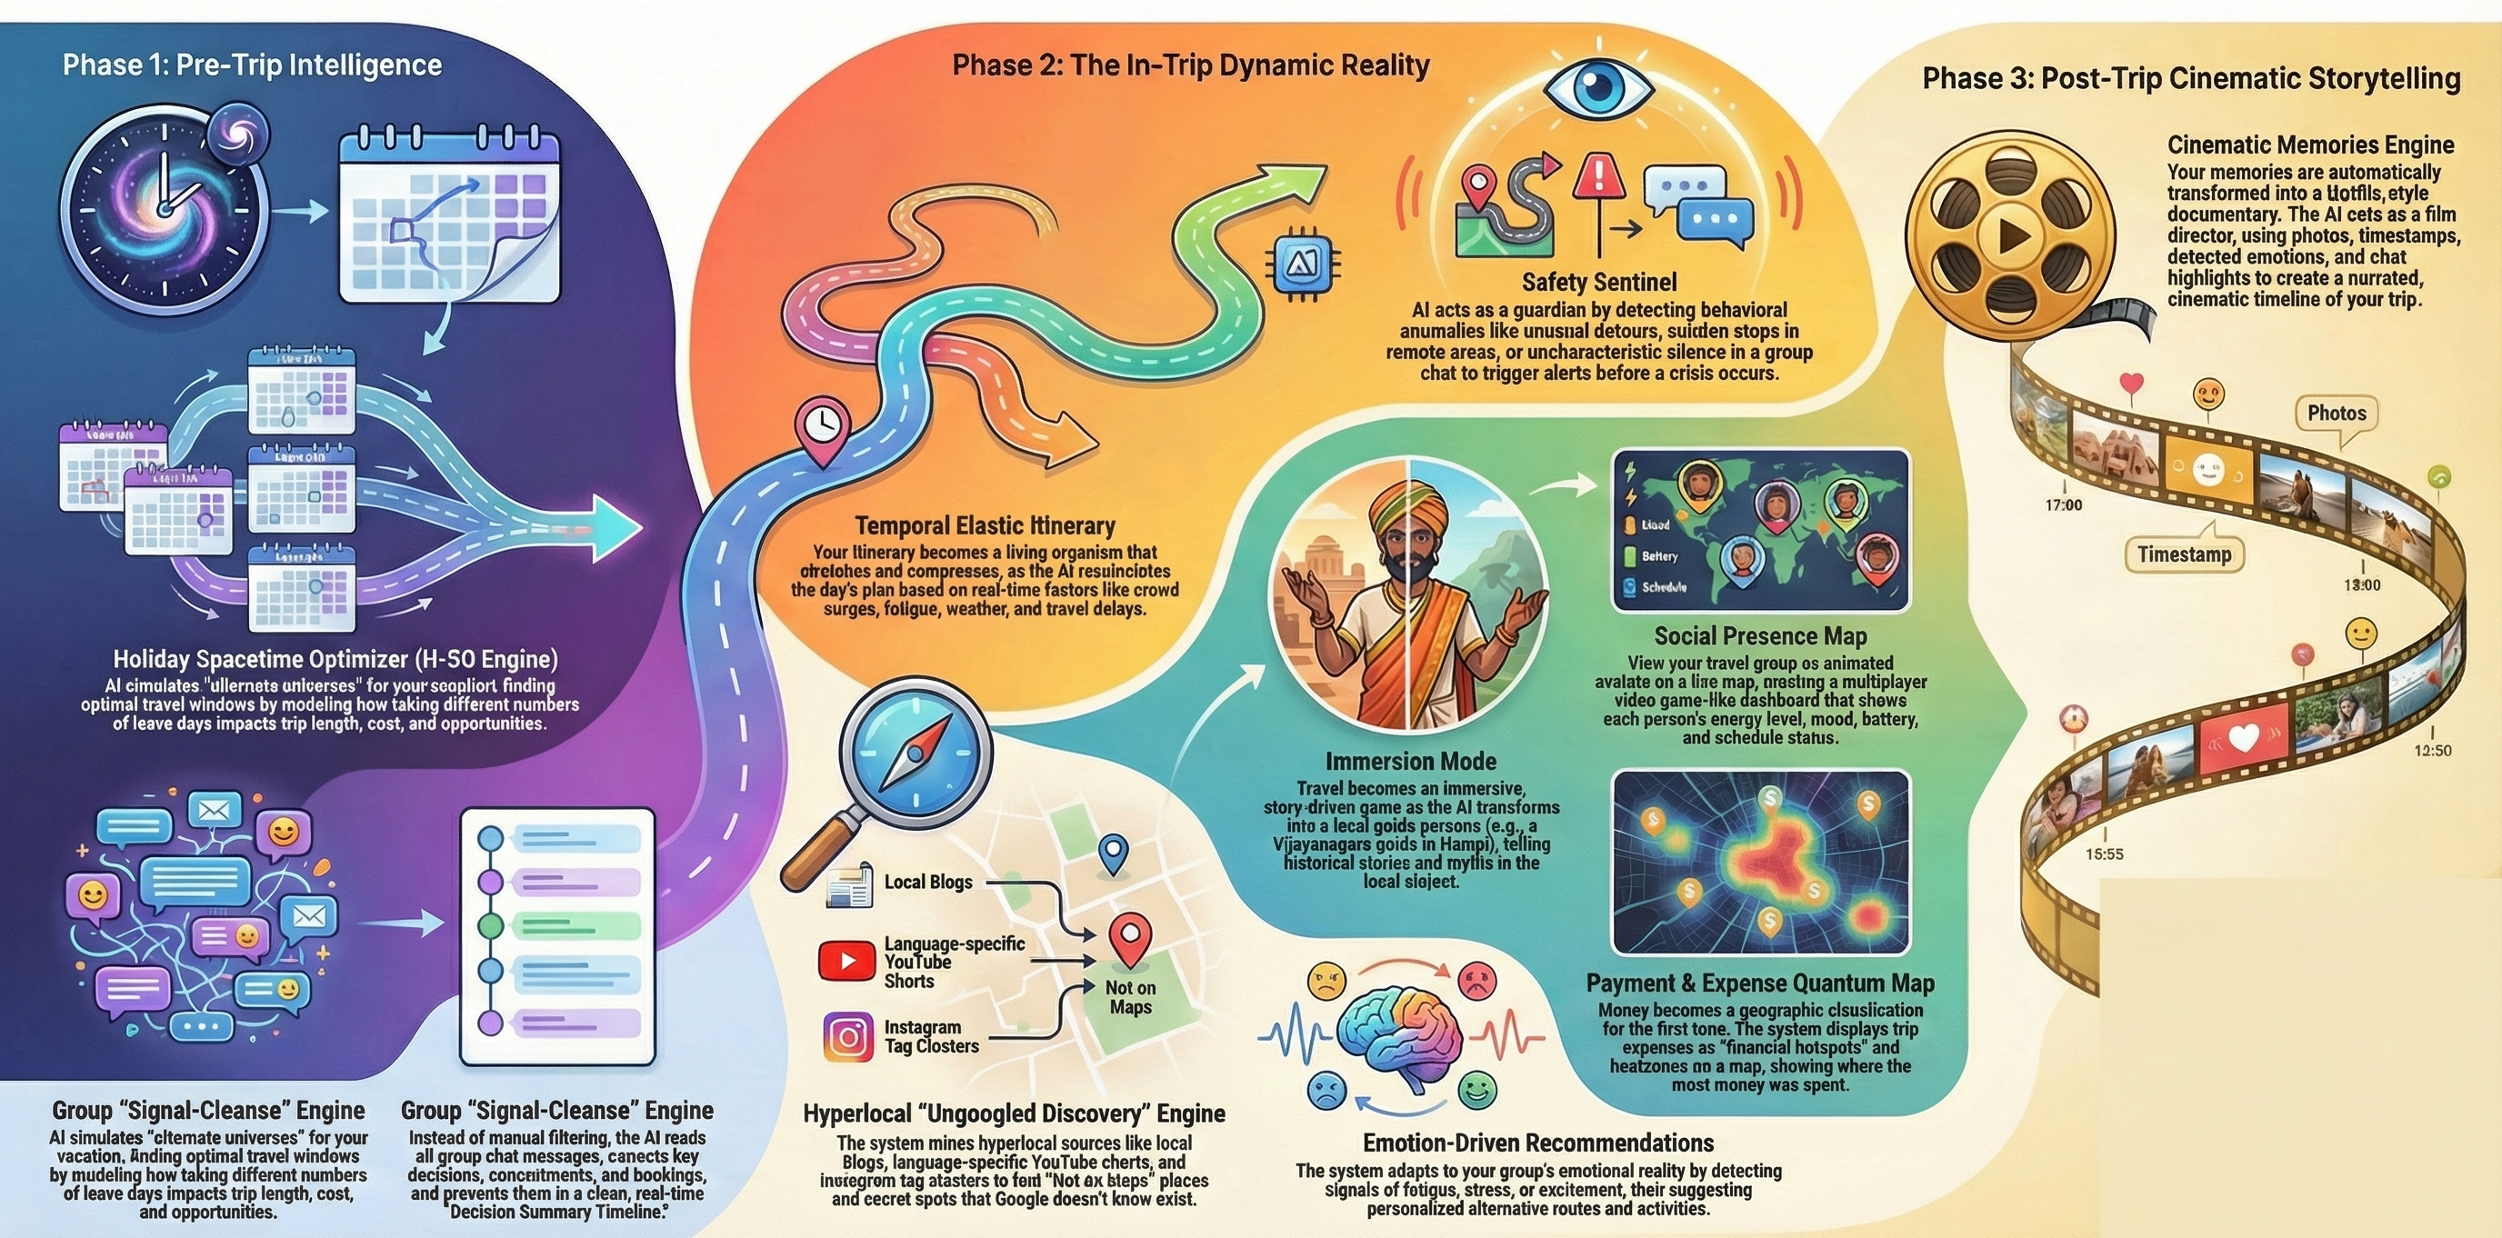
Proposed idea
Team ForgeX

Slide 4
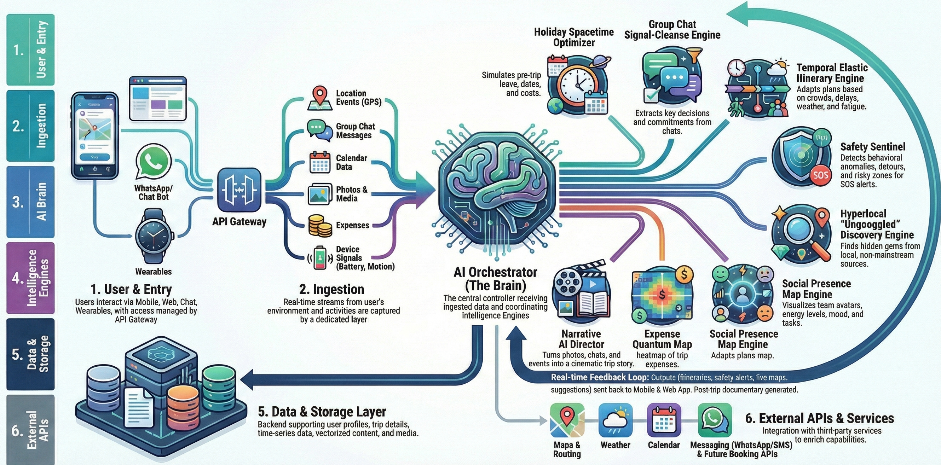
Team ForgeX
Process flow

Slide 5
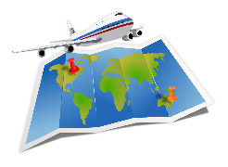
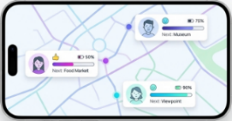

Team ForgeX
How this is Achievable?
Market Opportunity & Target Users
Built on Mature AI & Existing Tech:LLMs, multimodal models, and smartphone-native signals (GPS, battery, photos) already enable itinerary intelligence, safety, and storytelling.
Cloud-Ready & Real-Time:Event-driven cloud architecture supports live updates on crowds, safety, fatigue, and delays with no special hardware.
APIs & Integrations Already Available:Maps, weather, WhatsApp, Instagram, and tourism datasets make the system immediately implementable.
Phased Rollout is Straightforward:Start with Signal-Cleanse → Safety Sentinel → Elastic Itinerary, then expand to full AI Travel OS.
Global travel & tourism industry: $9–10 trillion annually
Over 1.3 billion international travellers every year
Demand for AI-enabled travel, safety & planning rising rapidly
Crisis-management, safety tech, navigation & experience apps = booming
Indian domestic tourism: ~2 billion annual trips
Smartphone-first travellers using navigation, discovery & itinerary apps
Group travellers, solo travellers, students, backpackers
Hospitality partners, city tourism boards, travel communities
Metro travellers, weekend travellers, campus travel groups
Hill-stations, historical circuits, cultural tourism hubs
Hostel chains, local guides, homestays, backpacker hostels
State tourism partnerships (Hampi, Mysuru, Goa, Kerala etc.)
Total Addressable Market
Serviceable Available Market
Serviceable Obtainable Market
The Positive Change We Create
Transforms Travel From Stressful to Effortless:No more chaotic planning, group confusion, or information overload — AI handles the complexity.
Creates Safer Travel for Everyone:Proactive safety through behavioral anomaly detection helps prevent issues before they escalate.
Revives Local Communities & Micro-Tourism:Ungoogled discovery pushes travellers toward small businesses, local guides, lesser-known food spots, and authentic cultural places.
Promotes Emotionally Conscious & Inclusive Travel:Trips adapt to fatigue, mood, stress, energy, and accessibility needs — making travel easier for elderly, anxious, or first-time travellers.
Sets a New Standard for Hospitality:From booking → exploring → storytelling, travel becomes an intelligent, living experience.
The Value to the User
Effortless Planning:The AI eliminates 80–90% of decision fatigue by summarizing chats, choosing dates, optimizing routes, and auto-fixing plans.
A Trip That Adapts to You:Your itinerary flexes with real-time reality — crowds, delays, fatigue, hunger, weather, mood, or energy levels.
Peace of Mind Everywhere You Go:A silent guardian that watches for unusual detours, risky zones, silence, low battery, or separation — triggering early alerts.
Authentic Travel, Not Tourist Traps:Hyperlocal hidden gems, culture-rich spots, local stories, and micro-lore the internet usually hides.
Living Memories That Tell Your Story:A cinematic, AI-narrated recap of your trip: photos + emotions + timestamps + moments blended into a documentary.

Slide 6
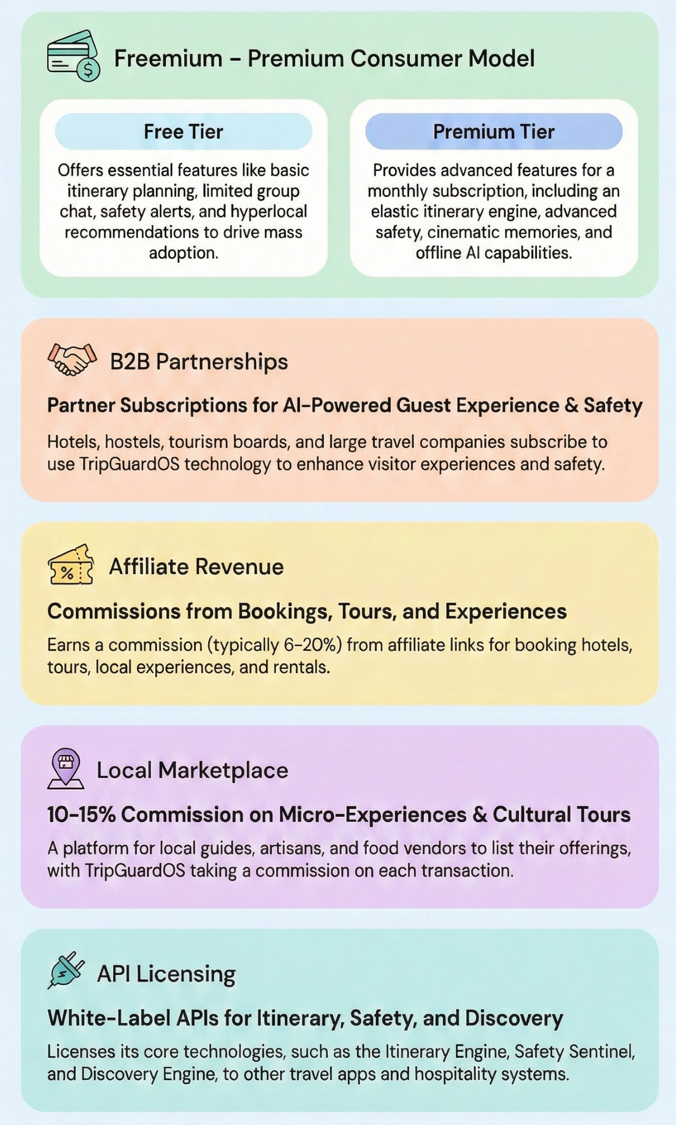















Business model
Techstack
Team ForgeX
CATEGORY | TECHSTACK
USER LAYER
BACKEND & APIS
MULTI-AGENTS
DEPLOYMENT
STORAGE
MODELS

Slide 7

Team ForgeX
Research and References
RESEARCH & REFERENCES
UNWTO – Global Tourism Statistics & Market Insights
Provides authentic data on international travellers, market size, safety trends, and tourism growth — used in your TAM/SAM/SOM.
WTTC – Travel & Tourism Economic Impact Report
Offers data on tourism GDP contribution, travel spending, and technology adoption trends in travel. Google Maps Platform Documentation
Official reference for routing, ETA, geospatial APIs, and traffic models used in itinerary shaping and real-time adjustments.
OpenAI Research – GPT-4/GPT-5 Technical Reports
Covers multimodal reasoning, summarisation, and narrative generation techniques used in Signal Cleanse, Immersion Mode, and Cinematic Memories.
IEEE Xplore – Mobility & Anomaly Detection Research
Peer-reviewed research on detecting unusual movement patterns, silence, detours, and safety anomalies using smartphone sensors.
Ministry of Tourism, Government of India – Tourism Statistics
Authentic datasets on Indian domestic tourism (2B+ annual trips), cultural circuits, and heritage sites.

